Slide 1
AMBA AHB bus 2.0 MUKESH KUMAR

Slide 2
AMBA AHB Bus 2.0
AHB is a new generation of AMBA bus which is intended to address the requirements of high – performance synthesizable designs.
High –performance system bus that supports multiple bus masters and provides high – bandwidth operation.

Slide 3
Features
Burst transfers
Split transactions
Single – cycle bus master handover
Single – clock edge operation
Non – tri state implementation
Wider data bus configuration(64/128 bits)

Slide 4
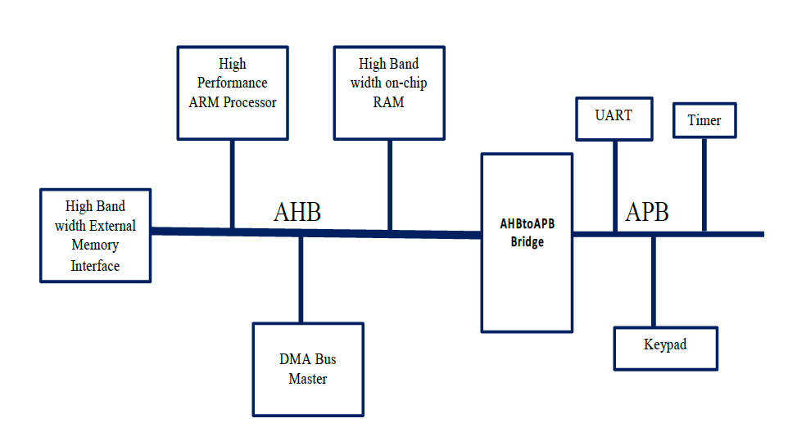
ABMA AHB based system

Slide 5
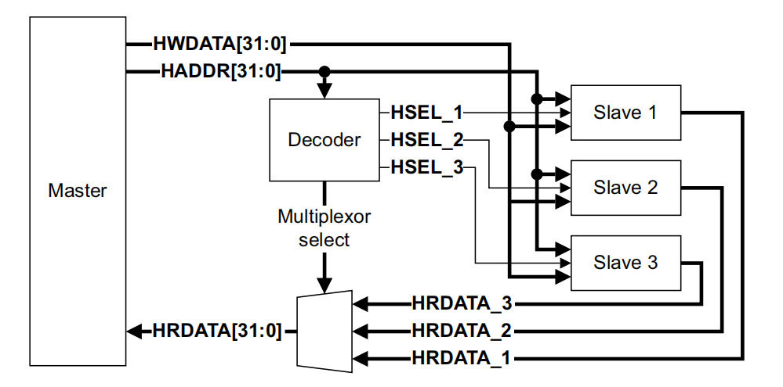
AHB BLOCK DAIGRAM

Slide 6
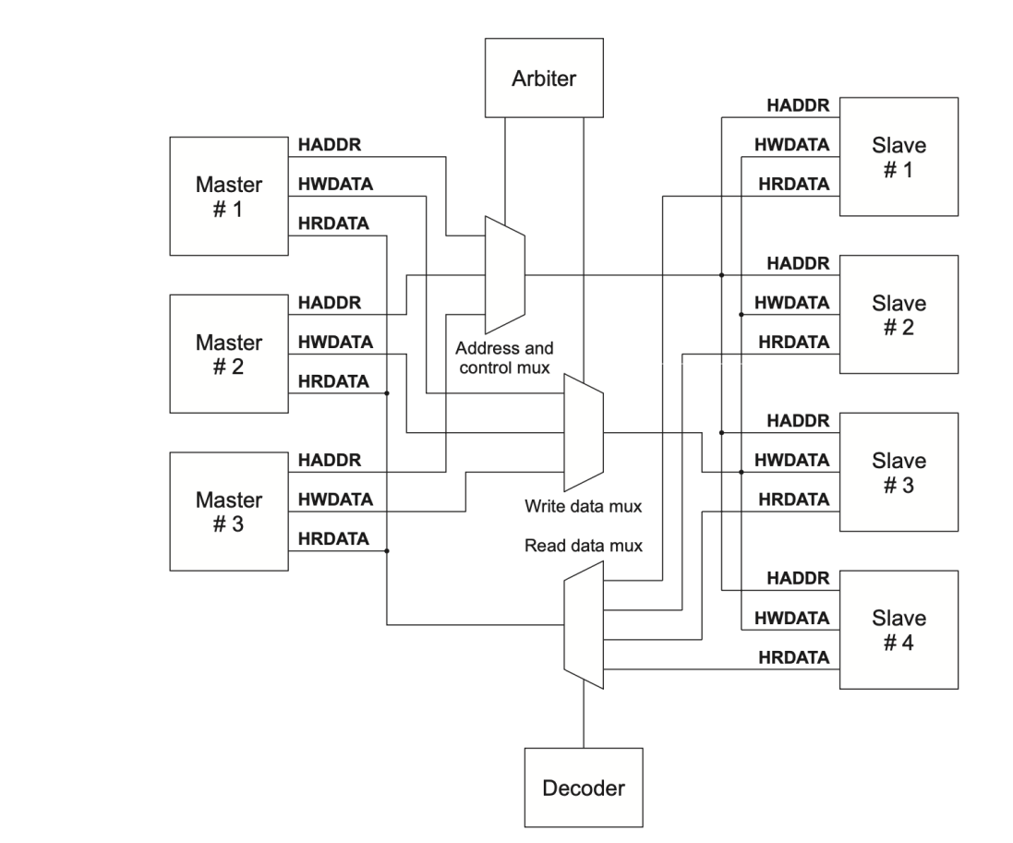
MULTIPLEXER INTERCONNECTION

Slide 7
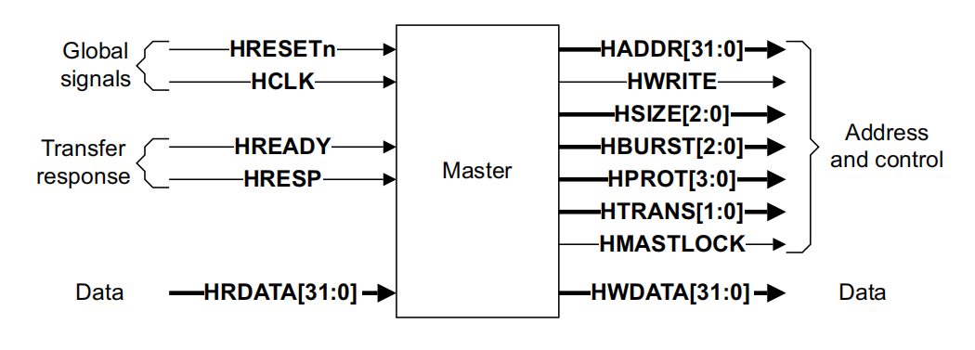
AHB master interface

Slide 8
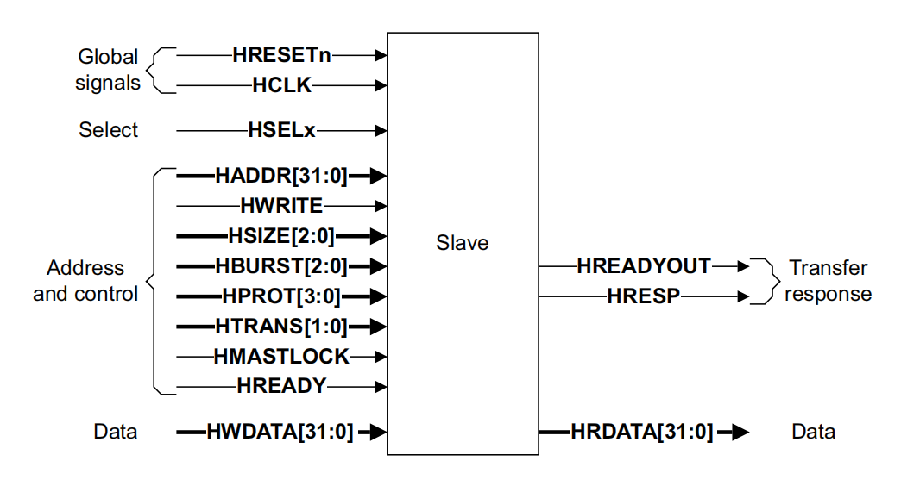
AHB Slave interface

Slide 9
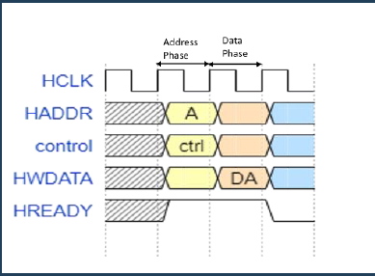
AHB Operation Basic transfer

Slide 10
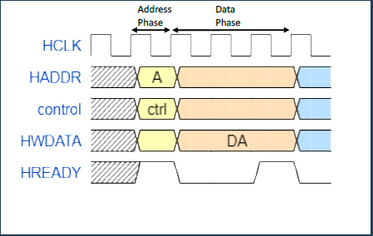
Transfer with wait state

Slide 11
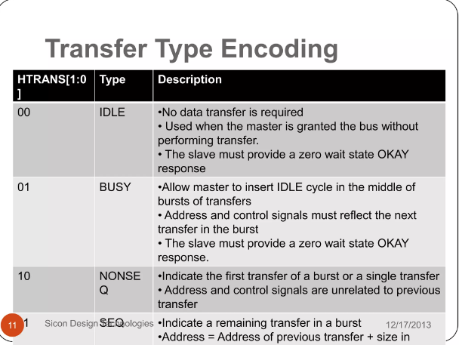

Slide 12
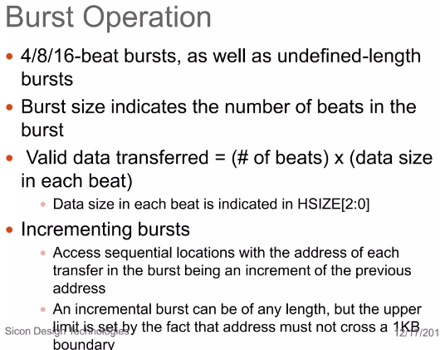

Slide 13
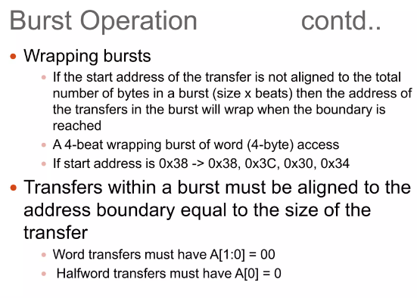

Slide 14
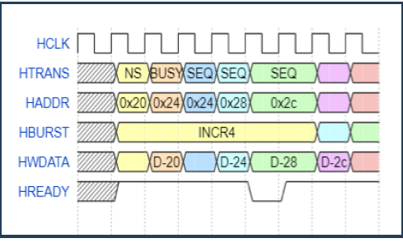
Burst transfer(increment)- pipelined operation

Slide 15
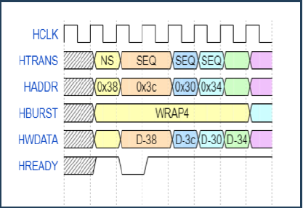
Burst transfer (wrapping)-pipelined operation

Slide 16
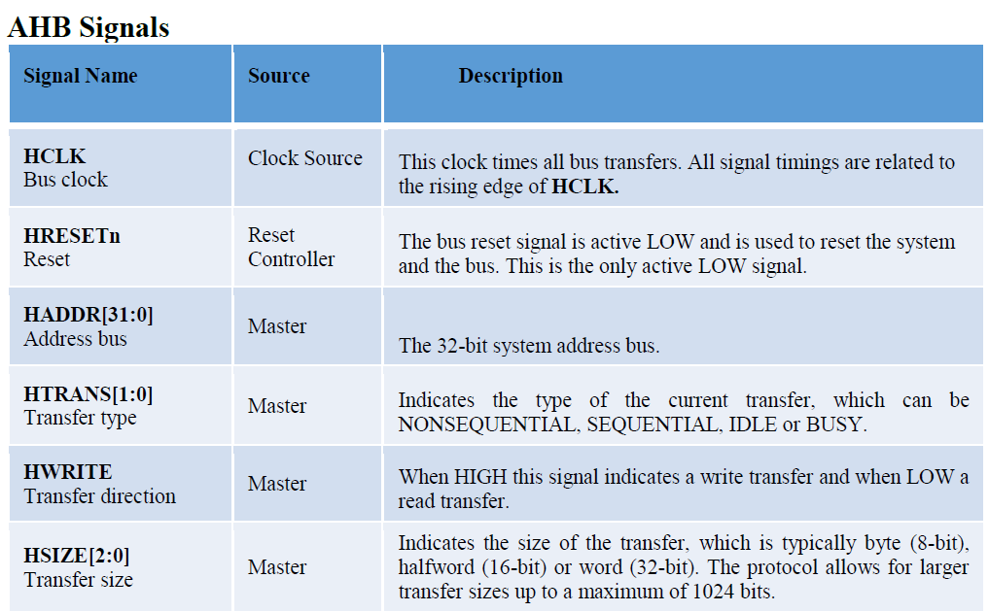

Slide 17
